Slide 1

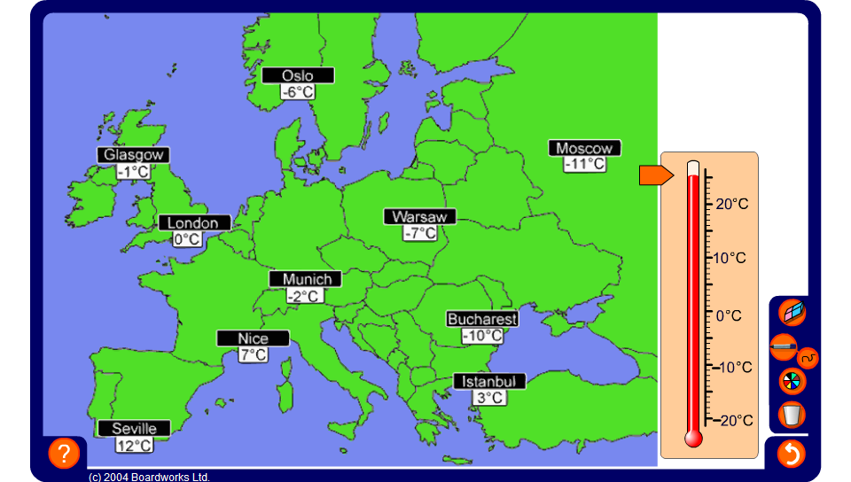


Comparing temperatures
Notes:
Look at this map of temperatures around Europe on a day in January.
The questions below may be answered orally as a group warm up activity or may be set as a written exercise. Use the vertical thermometer at the side to illustrate answers.
What is the coldest place on the map?
What is the warmest place on the map?
Which city is 4°C warmer than Glasgow?
Which city is 8°C warmer than Bucharest?
Which city is 10°C cooler than Istanbul?
Which city is 18°C cooler than Nice?
What is the difference in temperature between Seville and Istanbul?
What is the difference in temperature between Moscow and Glasgow?
What is the difference in temperature between Warsaw and Nice?
Write the names of the cities in order from coldest to warmest.

